Slide 1
AI Signal Processing Enterperise Neurosytems Group
Nancy Greco, grecon@us.ibm.com,
Tadanobu Inoue, inouet@jp.ibm.com
David Wood, dawood@us.ibm.com
April 1, 2022

Slide 2
AI Signal Processing
Vision
Open source software and solutions that use AI to improve processing of real-time signals including acoustics, vibration, and other high data rate signals.
Support enterprise use cases in classification, anomaly detection, clustering, change point detection and others as community evolves.
Type – software
Framework/library
Command line tools
Cloud services
Applications
Team
IBM, RedHat, Kove, SLAC

Slide 3
Agenda
Acoustic Use Cases
Systems Overview
Proposed Open Source Contributions
Gateway and CLI Demonstration
Advanced topics
Future Work
Code Organization and Packaging

Slide 4
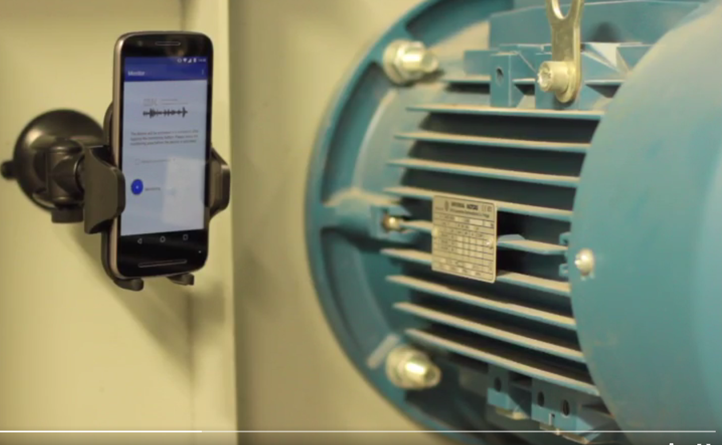
IoT Acoustics Use Case
Enables the detection and management of acoustic anomalies/state at the edge
Sounds captured in situ to build and grow acoustics models in real-time
Edge client identifies sounds and notifies backend systems
Watson IoT platform support enables easy integration and extension
Continuous Monitoring
Quality Assurance

Slide 5
Other Potential Use Cases
Manufacturing: detecting welding defects acoustically
Manufacturing: electrical connecters properly connected via click sound
Quality: Detecting and isolating sounds post assembly (cars, appliances, etc)
Operation : detecting engine anomalies
Human : detecting different coughs for COPD clients
Poultry: early identification of illness in chicken pens
Whales : Mayflower crossing detecting whale songs
Bees : detecting health of the hive

Slide 6
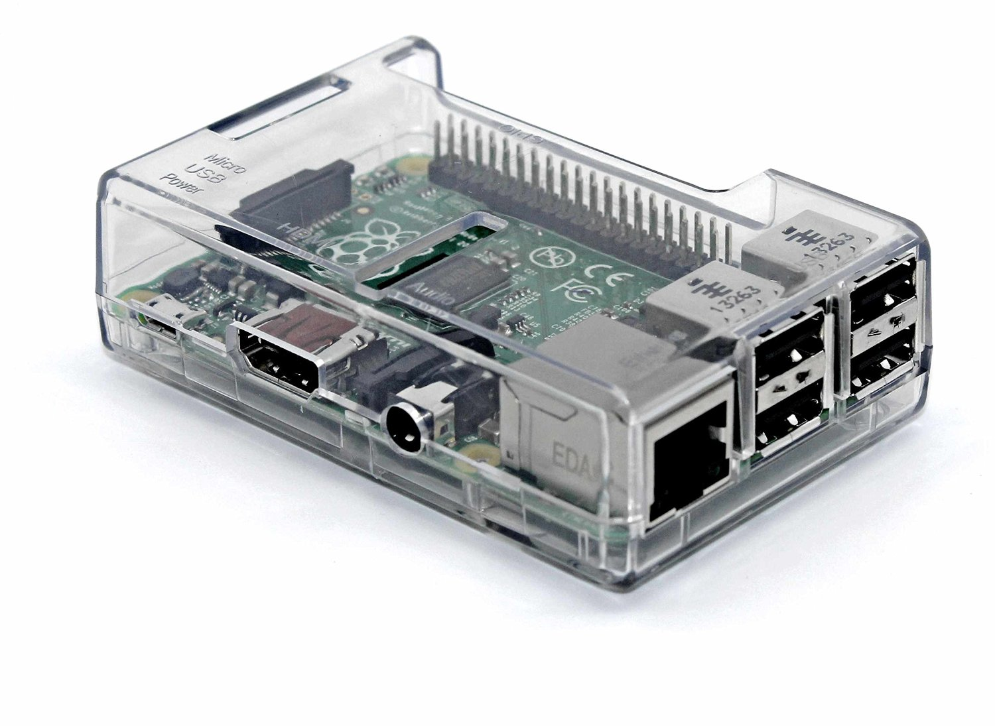
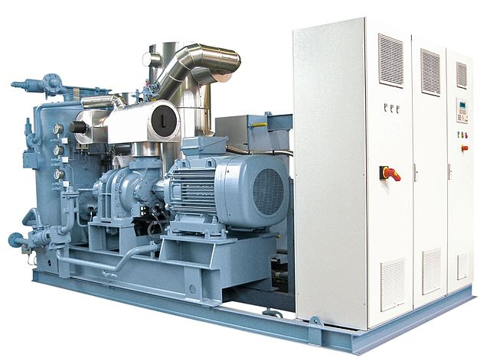
System Overview
On Site
Cloud
Classification Results
Workbench + API Server
MQTT Broker (Watson IOT)
Gateway
Training/monitored Data
Capture/ Classify
Classification Model
Sound/ Vibration
Data/Model
Storage
SME Location
3rd Party Application
Notification
Monitored Equipment
Workbench Labeling/Training

Slide 7
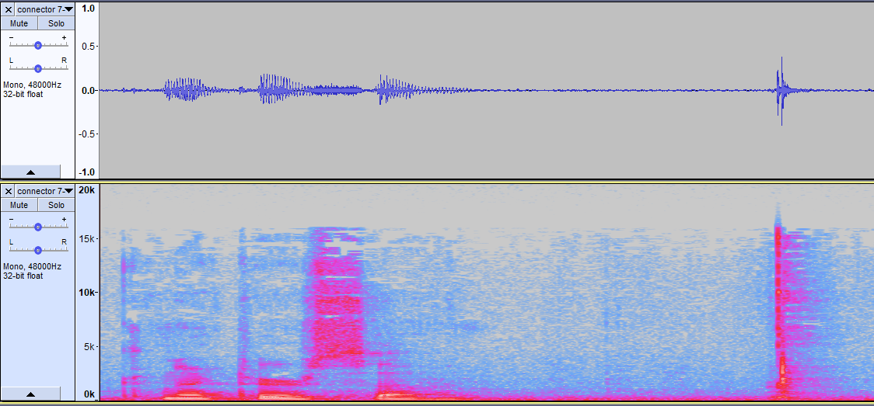
Spectrograms – An Acoustic Image
Frequency-based features extracted from sub-windows through time
Models train on labeled spectrograms
Models inference/classify to determine best label from training data
Training Labels
Voice
Ambient
Click
Raw Sound
Sub-window
Spectrogram

Slide 8
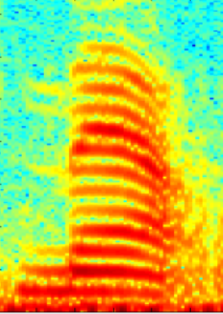
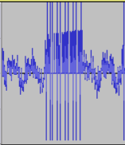
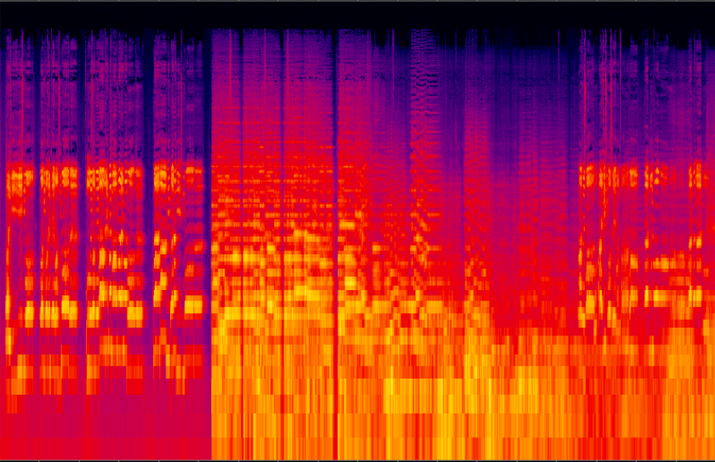
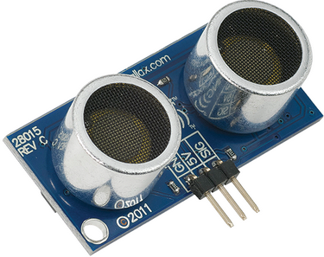
Signal Treatment for Training and Classifying
PCM data segment (1..N seconds) is scaled into doubles in range [-1,1]
Optional data augmentation to produce acoustic variants (pitch, noise, etc) during training only
Sub-windows are extracted
A feature extractor (MFCC, DCT, FFT, etc) generates a 1-D vector, combined to create a single channel spectrogram.
Feature Processor (Normalize, velocity, acceleration, etc) can further manipulate features
Algorithm learns on pipelined labeled signal. Classifier determines label from pipelined signal
double[]
Feature/Spectrogram Extractor
Scale [-1,1]
Augment
Extract Sub-windows/ frames
Feature
Extraction
Feature Processing (Norm, d/dt, etc)
Algorithm
…
…
Train
Classify
N/M
M sec frames
(N/M) x (M*sample rate (hz)) matrix
(N/M) x ?₂ matrix (spectrogram)
Signal Source
Add/Edit
(Training only)
N sec
signal
M sec
frames
(N/M) x ?₁ matrix
(spectrogram)
Train and Classify are agnostic to the specifics of the upstream spectrogram generation
Embarrassingly parallel operation is highly optimized w/multi-threading and caching
All processing is done using Java Iterables to enable streaming of the data

Slide 9
Available Pipeline Components
Feature Extractors
FFT – simple power spectrum
MFFB – Mel-Frequency Filter Bank. Tuned to the human ear.
MFCC – Mel-Frequency Cepstral Coefficients. MFFB followed by DCT.
LogMel – MFFB using log of feature vector.
Feature Processors
Deltas – computes 1st and/or 2nd derivatives through time.
Normalization – scales spectrogram into a fixed range.
Classifiers
KNN – Saves trained/merged features, classification finds nearest neighbor.
SVM - Support vector machine framework for audio classification
CNN - Deep model – easily extendible to alternate network structure.
Ensemble - Scores combinations of feature extractors with above algorithms to find top N classifiers.
TwoPhase - Uses two Ensemble models (by default), the first to detect outliers, and the 2nd to classify.
MultiLabel - Uses multiple models to independently train and classify on more than 1 label
Anomaly Detectors score outliers.
Nearest Neighbor - Uses feature distances to score outliers.
Normal Distribution - Builds normal distributions on feature vector elements and votes across elements

Slide 10
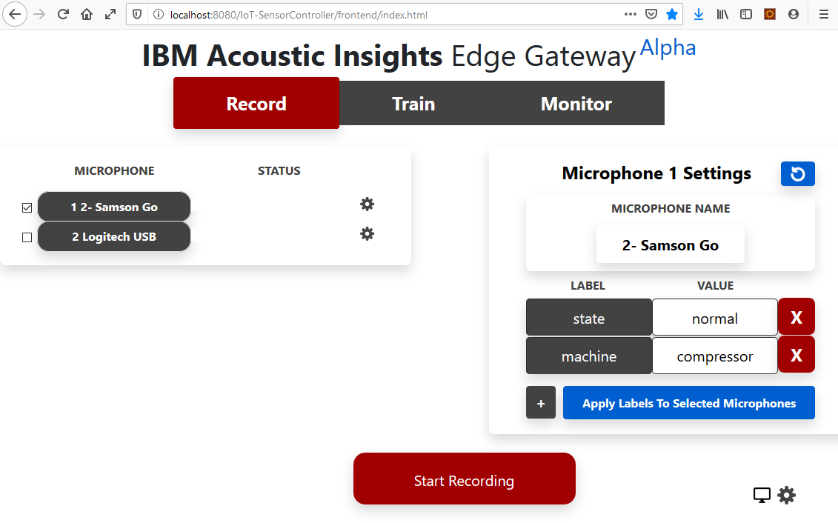
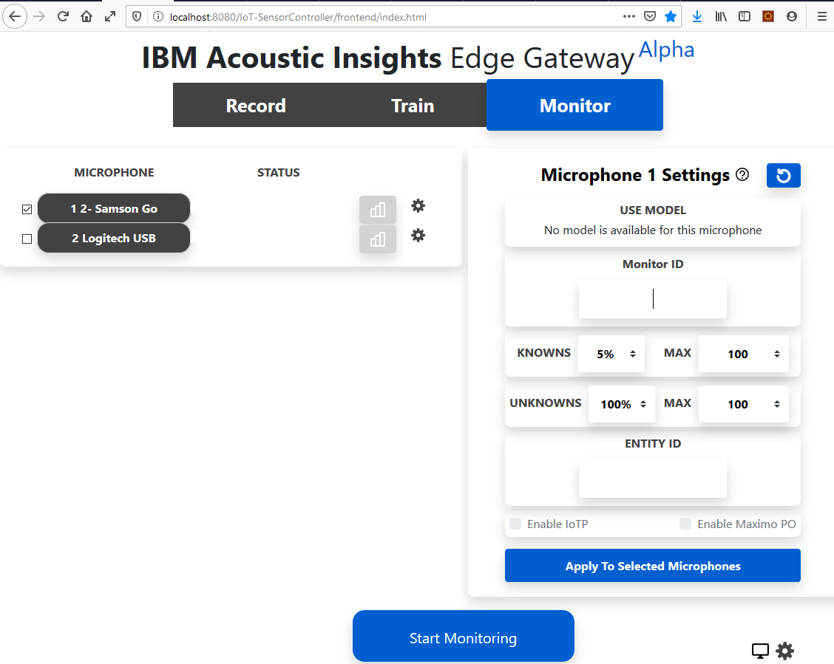
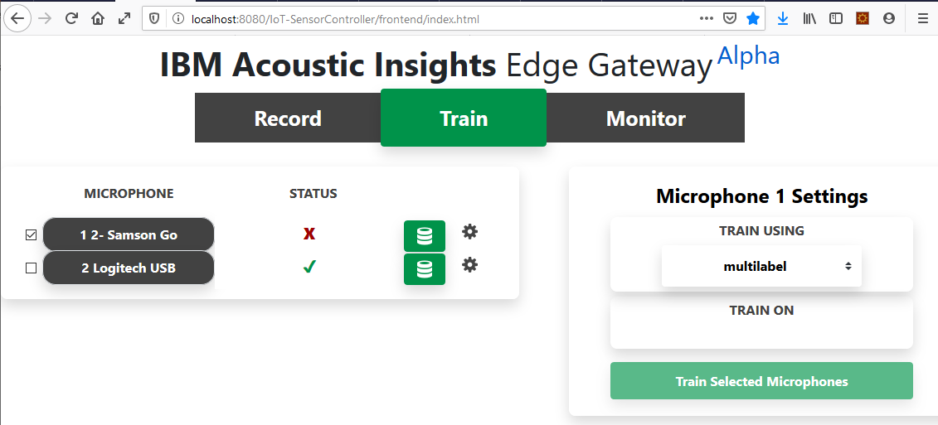
Multi-sensor/microphone Gateway
Web-based gateway
Capture, train, monitor on the edge
Manages multiple microphones

Slide 11
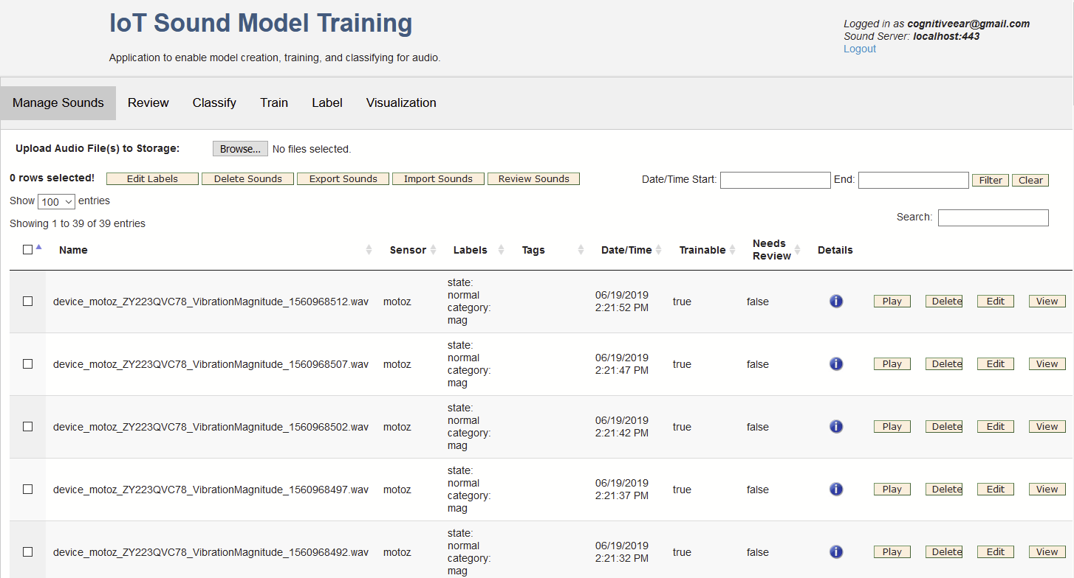
Sound Modeling Workbench
Sound Curation
Labeling, listening to and management of individual sound clips
Recording session review
Model Training/Evaluation
Train on a selection of sounds and labels using a selected model
Classify an uploaded sound using an existing model

Slide 12
Command Line Tools
Available on both Windows and Linux
Training/classification/curation (highlights)
evaluate – determines the accuracy of a model using k-fold evaluation.
train – trains a model on local or remote sounds
classify – classify one or more sounds using a stored model.
sound-info – show summary stats for a data set.
ls-models – list available models and details
…
Database management
modeldb – add, remove, list models in db
sounddb – add, remove, list, retrieve sounds from db
Can be run against a local Mongo instance or the REST Server.

Slide 13
CLI Example – File system data sets
Sounds in the file system are labeled with a CSV file
1 or more labels (name=value) can be assigned
Optional tag (name=value) can also be assigned
Sub-segments of a larger file can be labeled.
metadata.csv to label sounds with source and status labels
CarEngine.wav,source=engine;status=normal,
Compressor.wav,source=compressor;status=normal,
Machine.wav,source=machine;status=normal,
OneCylinderEngine.wav[100-1000],source=engine;status=abnormal,

Slide 14
CLI Example – sound-info
Data sets can be summarized using sound-info tool
For example, using engine sounds metadata.csv
CarEngine.wav,source=engine;status=normal,
Compressor.wav,source=compressor;status=normal,
Machine.wav,source=machine;status=normal,
OneCylinderEngine.wav[100-1000],source=engine;status=abnormal,
sound-info -sounds metadata.csv -clipLen 1000
Sounds will be clipped into 1000.0 millisecond clips (padding=NoPad).
Total: 168 samples, 2 label(s), 00:02:48.000 hr:min:sec
Label: source, 168 samples, 3 value(s), 00:02:48.000 hr:min:sec
Value: compressor, 32 samples, 00:00:32.000 hr:min:sec
Value: engine, 60 samples, 00:01:0.000 hr:min:sec
Value: machine, 76 samples, 00:01:16.000 hr:min:sec
Label: status, 168 samples, 1 value(s), 00:02:48.000 hr:min:sec
Value: normal, 168 samples, 00:02:48.000 hr:min:sec

Slide 15
CLI Example - evaluate
K-fold cross validation supported via evaluate tool
evaluate –sounds metadata.csv –clipLen 1000 –label source –model lpknn –cm
Loading sounds from [metadata.csv]
Sounds will be clipped into 1000.0 millisecond clips (padding=NoPad).
Training and evaluating classifier (KNNDistanceMergeClassifier)
Sounds : Total: 168 samples, 2 label(s), 00:02:48.000 hr:min:sec
Label: source, 168 samples, 3 value(s), 00:02:48.000 hr:min:sec
Value: compressor, 32 samples, 00:00:32.000 hr:min:sec
Value: engine, 60 samples, 00:01:0.000 hr:min:sec
Value: machine, 76 samples, 00:01:16.000 hr:min:sec
Label: status, 168 samples, 1 value(s), 00:02:48.000 hr:min:sec
Value: normal, 168 samples, 00:02:48.000 hr:min:sec
Evaluating 4 of 4 folds .
Evaluation completed in 4311 msec. 1077 msec/fold (computed in parallel)
Evaluated label name: source
…

Slide 16
CLI Example – evaluate (cont)
COUNT MATRIX:
Predicted ->[ compressor ][ engine ][ machine ]
compressor ->[ * 32 * ][ 0 ][ 0 ]
engine ->[ 0 ][ * 60 * ][ 0 ]
machine ->[ 0 ][ 0 ][ * 76 * ]
PERCENT MATRIX:
Predicted ->[ compressor ][ engine ][ machine ]
compressor ->[ * 19.05 * ][ 0.00 ][ 0.00 ]
engine ->[ 0.00 ][ * 35.71 * ][ 0.00 ]
machine ->[ 0.00 ][ 0.00 ][ * 45.24 * ]
Label | Count | F1 | Precision | Recall
compressor | 32 | 100.000 | 100.000 | 100.000
engine | 60 | 100.000 | 100.000 | 100.000
machine | 76 | 100.000 | 100.000 | 100.000
Micro-averaged | 168 | 100.000 | 100.000 | 100.000
Macro-averaged | 168 | 100.000 | 100.000 | 100.000
Precision: 100.000 +/- 0.0000% (micro), 100.000 +/- 0.0000% (macro)
Recall : 100.000 +/- 0.0000% (micro), 100.000 +/- 0.0000% (macro)
F1 : 100.000 +/- 0.0000% (micro), 100.000 +/- 0.0000% (macro)

Slide 17
CLI Example - train
Models are trained with the train tool
train –sounds metadata.csv –clipLen 1000 –label source –model lpknn –output mylpknn.cfr
Loading sounds from [metadata.csv]
Sounds will be clipped into 1000.0 millisecond clips (padding=NoPad).
Training local model on label source
Training using classifier KNNDistanceMergeClassifier […]
Training sounds: Total: 168 samples, 2 label(s), 00:02:48.000 hr:min:sec
Label: source, 168 samples, 3 value(s), 00:02:48.000 hr:min:sec
Value: compressor, 32 samples, 00:00:32.000 hr:min:sec
Value: engine, 60 samples, 00:01:0.000 hr:min:sec
Value: machine, 76 samples, 00:01:16.000 hr:min:sec
Label: status, 168 samples, 1 value(s), 00:02:48.000 hr:min:sec
Value: normal, 168 samples, 00:02:48.000 hr:min:sec
Trained classifier: GMMClassifier
Completed model training in 2.003 seconds, 1.1922619047619047% of training data
Wrote trained classifier to file mylpknn.cfr

Slide 18
CLI – classify
To classify sounds, use the classify tool
Immediate – classifies sounds in the file system
Server – exposes a REST server to classification
classify -file mylpknn.cfr -sounds metadata.csv -clipLen 1000
Loading sounds from [metadata.csv]
Sounds will be clipped into 1000.0 millisecond clips (padding=NoPad).
C:\dev\sounds\class-sounds/CarEngine.wav[0][0-1000 msec]: source=engine confidence=1.0000
C:\dev\sounds\class-sounds/CarEngine.wav[1][1000-2000 msec]: source=engine confidence=1.0000
C:\dev\sounds\class-sounds/CarEngine.wav[2][2000-3000 msec]: source=engine confidence=1.0000
C:\dev\sounds\class-sounds/CarEngine.wav[3][3000-4000 msec]: source=engine confidence=1.0000
C:\dev\sounds\class-sounds/CarEngine.wav[4][4000-5000 msec]: source=engine confidence=1.0000
C:\dev\sounds\class-sounds/CarEngine.wav[5][5000-6000 msec]: source=engine confidence=1.0000
…
classify -file mylpknn.cfr -server –server-port 8081
…
Classify server started on port 8081.
…

Slide 19
Advanced Topics (see wiki)
Model modification and tuning (video to be available)
Labeling using Audacity (video to be available)
REST APIs
Multi-dimensional models (e.g., 3-axis accelerometer)
Writing a new Java or Python classifier/anomaly detector
Code organization

Slide 20
Open Source Contributions
Framework
Applications/Servers
Classifiers (deep and shallow)
kNN, CNN
TwoPhase, Ensemble, Multilabel
Anomaly detection
kNN and Two-Phase
NormalDistributionAnomalyClassifier
Feature extraction
MFCC, LogMel, MFFB, FFT
Optimized/parallelized extraction pipeline
Miscellaneous
Storage framework & Mongo implementation
Jobs framework
Transforms/augmentations
Caching framework
JavaScript instantiation framework
Multi-dimensional spectrograms
CLI
Train, evaluate, classify, etc.
REST API server
Java client API wrappers
Gateway – record, train, monitor
Java client API wrappers
Change splash page (remove IBM)
Watson IoT Platform support
Workbench
Labeling, training, evaluating
Containerizations
Containers
CLI
Gateway
Workbench
REST Server
https://github.com/Enterprise-Neurosystem/ai-signal-processing
Framework

Slide 21
Next Steps
Finalize source code restructuring/clean-up
Populate ENG AI Signal Processing - targeting next week
https://github.com/Enterprise-Neurosystem/ai-signal-processing
Grow community of interest
Identify key focus areas, potential candidates…
Additional classifiers / anomaly detectors
Change point detection
Clustering
Model update/domain adaptation
Signal separation (e.g., voice)
Localization
Workbench extensions
Edge-enablement for dynamic model management

Slide 22
Backup

Slide 23
Edge Classification Performance – Shallow Model
Compare edge platforms
More cores and faster CPU is better
Memory has little or no impact
Edge Classify Performance
as Percentage of Clip Length
System Characteristics
Continuous monitoring threshold
Notes:
We tested one of our representative classifiers on small form-factor devices running the Linux OS. Devices ranged in characteristics from .55-1.2 Ghz, 1-4 cores, 256MB-4GB RAM, 32 and 64 bit - all running 32-bit JVMs from Oracle. The left-most graph shows these characteristics where the y-axis is in units as defined inside the () on the x-axis labels. The Leeo device, developed by a potential partner, plugs into a wall socket to provide continuous monitoring, primarily targeted at in-home use for safety and security.
The right-most graph shows metrics taken during classification of sounds on the various platforms. Again, the y-axis is defined by the text inside the parens () on the x-axis.
The first grouping shows the time it takes to classify a given clip as a percentage of the length of that clip with lower values being better. So for example a 50% value means that a 10 second clip will take 5 seconds to classify. Here we see the the values range from about 15-85%. This is good, since anything over 100% means the platform can not keep up with continuous sound capture.
The second grouping in the right-most chart shows the amount of memory in MB required by the JVM. Memory requirements are remarkably small at about 30 MB and roughly constant for all platforms.
The third grouping in the right-most chart shows the CPU utilization measured at the system level. Here we can see the effect of multiple cores as those will multiple cores (Pi3, NanoPi, Zynq) all have multiple cores and execute at over 100% utilization.
We can see here that our parallelization of feature extraction during classification is paying off, because the platforms with more cores and slower CPU are faster than the faster single core CPUs. In particular, the Zynq has 2 cores and a 550Mhz CPU and classifies at about 20% compared to the Pi Zero with a single 1Ghz core which is more than twice as slow at about 55%.
The bottom line across all these devices is that real-time continuous classification at the edge is viable on all of these platforms.

